Slide 1
JWT Hardening and Token Security
By Steven Beveridge and Sujeet Ramadurai

Slide 2
What is a JSON Web Token (JWT)
JWT Structure
A typical signed JWT consists of three parts separated by periods
Header: Identifies the token type and signing algorithm, such as HS256.
Payload: Contains claims like user ID (sub), permissions, issuer (iss), and expiration (exp).
Signature: Allows the API to verify token integrity and authenticity using a trusted cryptographic key.
How JWT Authentication Works
User logs in with credentials
Server authenticates user and issues a signed JWT
Client sends JWT with subsequent API requests
API validates the token before granting access
Notes:
A JSON Web Token, or JWT, is a common way for applications and APIs to exchange authentication and authorization information.
A typical signed JWT contains three components: the header, payload, and signature. The header identifies the signing algorithm, the payload contains information called claims, and the signature allows the receiving server to verify that the token hasn't been modified and was signed using a trusted key.
When a user logs in, the server verifies their credentials and generates a JWT. The client then includes that token in future requests, and the API validates it before granting access.
One important security consideration is that JWT payloads are encoded rather than encrypted. This means anyone who obtains the token can read its claims. If an application uses weak signing keys, fails to verify signatures, or doesn't enforce expiration, attackers may be able to exploit those weaknesses.
Our project demonstrates these vulnerabilities and shows how proper JWT hardening can prevent them.

Slide 3
The Project
We developed a JWT testing environment that contains two implementations of JWT Authentication
The first implementation is intentionally vulnerable allowing us to demonstrate weaknesses and their potential impact
The second implementation applies security best practices to demonstrate proper token handling, validation, and mitigation of these vulnerabilities
Notes:
For this project, we developed a JWT security testing environment using Python, Flask, and the PyJWT library. The application runs locally on port 5000 and contains two implementations of JWT authentication.
The first implementation is intentionally vulnerable, allowing us to demonstrate issues such as weak signing secrets, missing expiration, excessive claims, and improper signature verification.
The second implementation applies security best practices, including strong cryptographic keys, short-lived access tokens, minimal claims, strict signature validation, and key rotation.
We use Postman and Burp Suite to send requests and test manipulated tokens, while jwt.io allows us to inspect token headers and payloads. We also use Pytest to automate tests and validate that the security controls behave as expected.
Our testing methodology is to identify a vulnerability, reproduce it in the controlled environment, implement or examine the remediation, and verify that the hardened API rejects the attack.

Slide 4
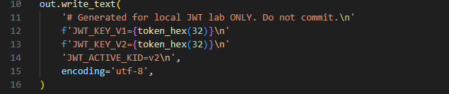
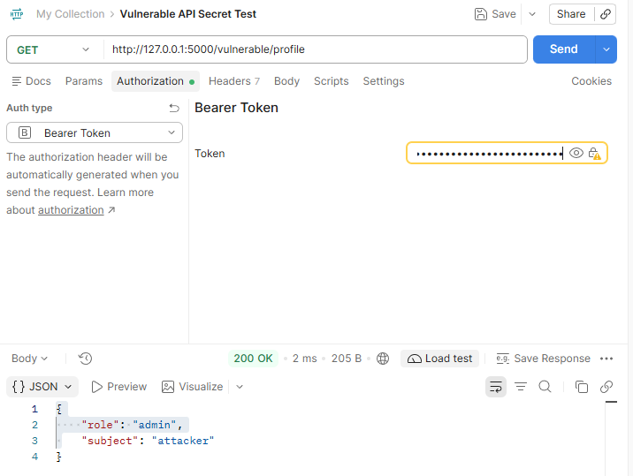
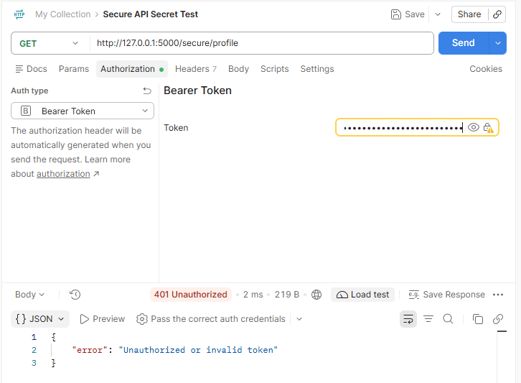
Weak Signing Secrets
Vulnerability: The vulnerable implementation uses a hardcoded, easily guessable signing secret (secret123).
Security Risk: An attacker who discovers the secret can forge JWTs, manipulate claims, and potentially gain unauthorized access.
Mitigation: The hardened implementation uses cryptographically secure, randomly generated signing keys stored outside the application source code.
Notes:
In this demonstration, we examined the security risks associated with weak JWT signing secrets.
Our vulnerable implementation uses a hardcoded secret, "secret123," to sign JWTs using the HS256 algorithm. Because this secret is predictable, an attacker who discovers or guesses it could generate their own JWTs with modified claims, potentially impersonating another user or escalating privileges.
To demonstrate this vulnerability, we created a forged JWT containing an administrator role and signed it using the known secret. When we submitted the token to our vulnerable API, it accepted the forged token and returned a successful response.
We then submitted the same token to our hardened API, which rejected it because the signature was not generated using one of its trusted signing keys.
To mitigate this vulnerability, our hardened implementation uses cryptographically secure, randomly generated signing keys stored outside the application source code.
This demonstrates why JWT security depends not only on the signing algorithm but also on the strength and protection of the signing key.
Attack name :JWT Secret Key Forgery

Slide 5
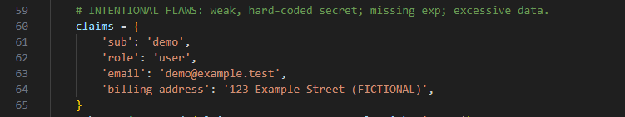
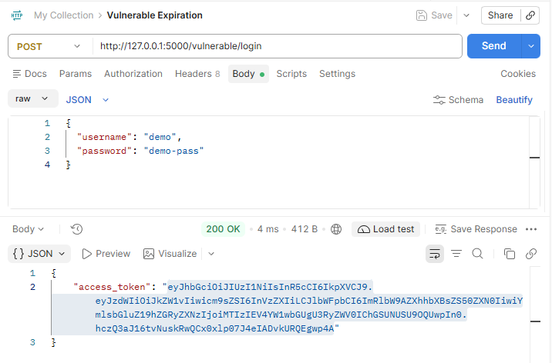
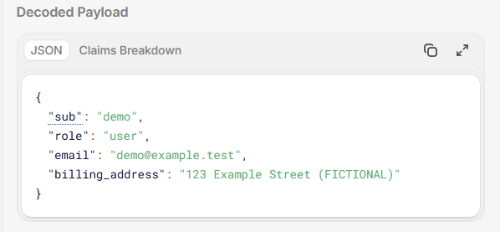
Missing Expiration
Vulnerability: The vulnerable implementation generates JWTs without an expiration (exp) claim, allowing tokens to remain valid indefinitely unless revoked or rejected for another reason.
Security Risk: A stolen token could be reused for an extended period, potentially allowing unauthorized access.
Mitigation: The hardened implementation requires an expiration claim and limits access tokens to a five-minute lifetime.
Notes:
In this demonstration, we examined the security risks associated with JWTs that do not have an expiration date.
Our vulnerable implementation generates tokens without an expiration claim. Because the API does not require this claim during validation, these tokens can remain valid indefinitely.
This creates a security risk because an attacker who obtains a valid token could potentially reuse it long after it was originally issued.
To demonstrate this vulnerability, we generated a JWT using our vulnerable API and decoded it to show that no expiration claim was present. We then submitted the token to the vulnerable endpoint, which accepted it.
Our hardened implementation addresses this issue by requiring an expiration claim and limiting access tokens to five minutes. We also implemented validation to reject expired tokens and tokens without an expiration claim.
This reduces the amount of time a compromised token can be used and demonstrates the importance of enforcing token lifetimes.
JSON decoded with jwt.io
JWT Replay Attack (Token Reuse)

Slide 6
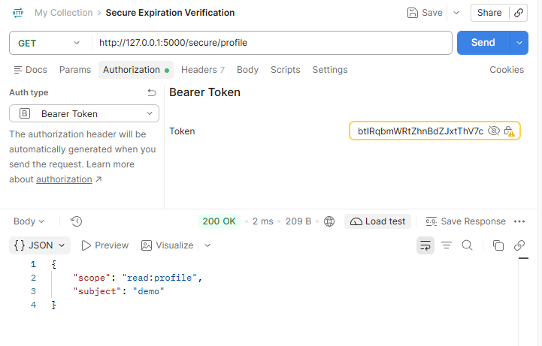
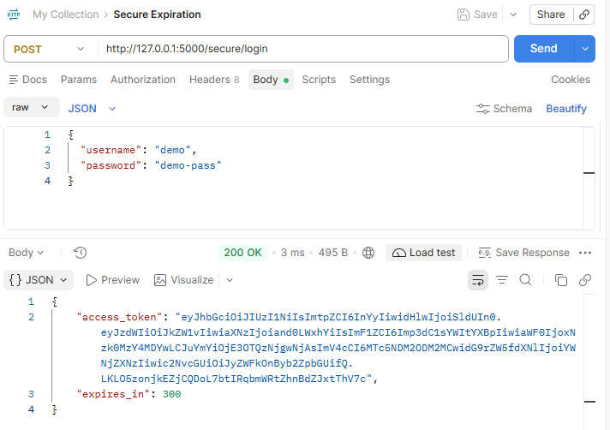
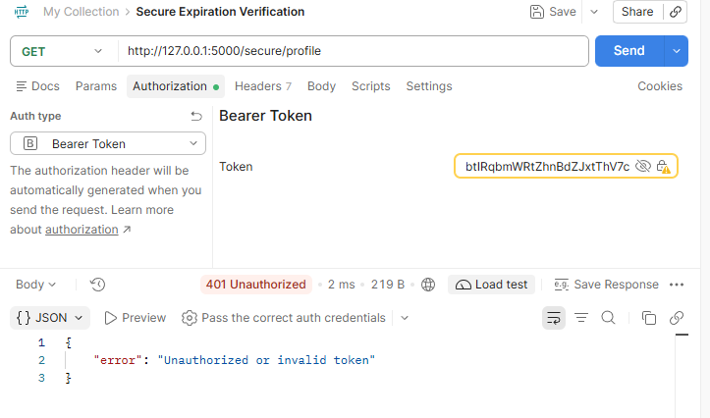
Missing Expiration - Secure

Slide 7
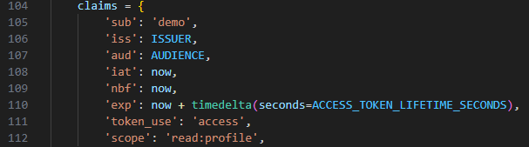
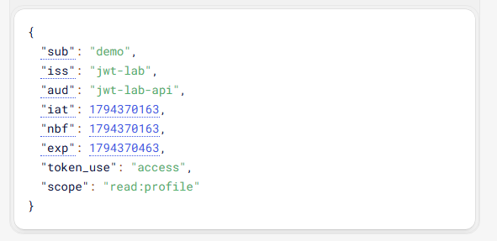
Excessive Claims
Vulnerability: The vulnerable implementation includes unnecessary personal information, such as email addresses and billing addresses, in the JWT payload.
Security Risk: JWT payloads are encoded, not encrypted. Anyone who obtains a token can decode its contents and view the information.
Mitigation: The hardened implementation follows the principle of data minimization, including only the claims necessary for authentication and authorization.
Notes:
For this demonstration, we examined the security risks associated with excessive JWT claims.
Claims are pieces of information stored in a JWT's payload. Our vulnerable implementation includes personal information such as an email address and billing address, even though this information isn't necessary for authentication.
The security concern is that JWT payloads are encoded using Base64URL, not encrypted. This means anyone who obtains a token can decode its contents without knowing the signing secret.
To demonstrate this vulnerability, we generated a JWT using our vulnerable API and decoded it using jwt.io. We were able to view the personal information directly from the payload.
We then generated a token using our hardened implementation, which excludes unnecessary personal information and includes only the claims required for authentication, authorization, and token validation.
This demonstrates the importance of data minimization when designing JWT-based authentication systems.

Slide 8
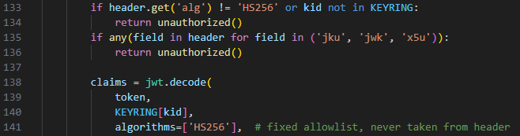
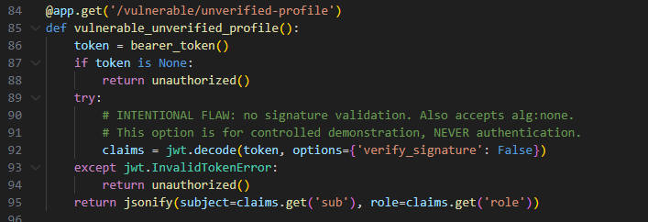
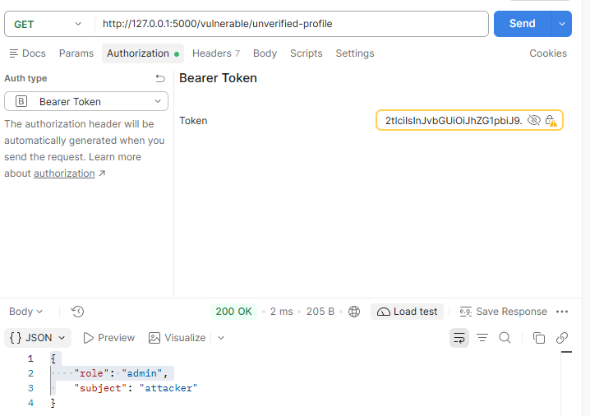
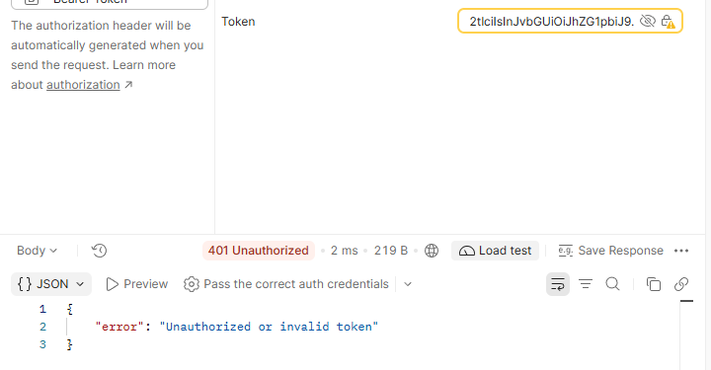
Signature Validation
Vulnerability: The vulnerable implementation disables JWT signature verification, allowing unsigned or forged tokens to be accepted.
Security Risk: Attackers could manipulate token claims to impersonate users or potentially gain unauthorized privileges.
Mitigation: The hardened implementation enforces cryptographic signature verification, restricts accepted algorithms to HS256, and validates tokens against trusted signing keys.
Notes:
For this demonstration, we examined improper JWT signature validation, specifically the risks associated with accepting unsigned tokens.
JWTs normally use cryptographic signatures to ensure that their contents have not been modified and were signed using a trusted key. However, our intentionally vulnerable implementation disables signature verification.
To demonstrate this weakness, we generated a JWT using the "none" algorithm, meaning the token did not contain a cryptographic signature. We modified its payload to identify the user as an attacker with an administrator role.
When we submitted the unsigned token to the vulnerable API, the application accepted it and returned the forged claims. This demonstrated how disabling signature verification allows attackers to supply untrusted authentication information.
We then submitted the same token to our hardened API. The request was rejected because the application requires the HS256 signing algorithm and validates token signatures against trusted cryptographic keys.
This vulnerability demonstrates why applications must never trust JWT claims without first verifying the token's signature and enforcing an explicit list of approved signing algorithms.
Attack: JWT Signature Verification Bypass (alg: none Attack).
Important clarification: In this lab, the insecure behavior results from explicitly setting verify_signature=False. Modern PyJWT does not normally accept unsigned tokens during verified decoding. You're demonstrating a deliberately introduced validation failure, not a flaw in the PyJWT library itself.

Slide 9
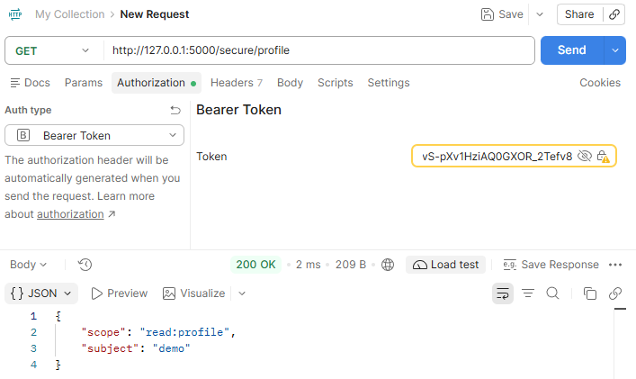
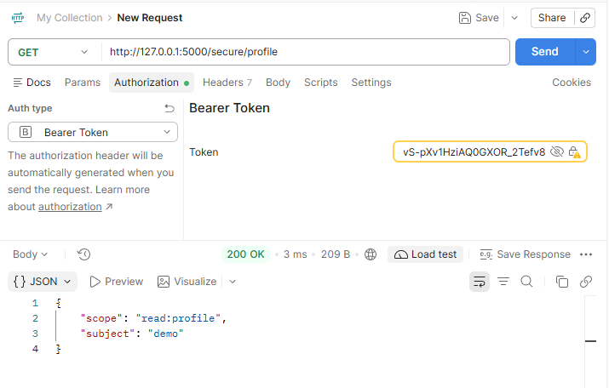
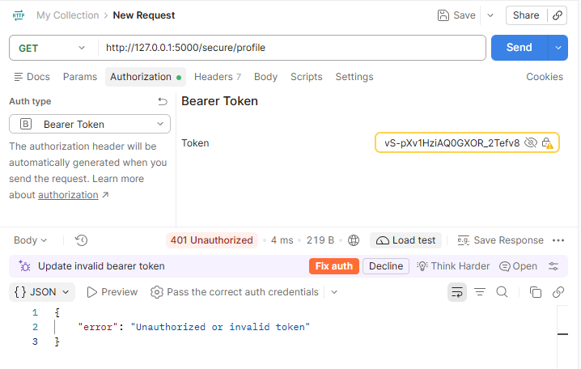


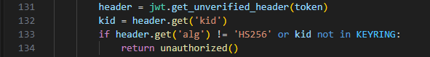
Key Rotation
Security Risk: Compromised or outdated signing keys can allow attackers to forge valid JWTs as long as those keys remain trusted.
Mitigation: The hardened implementation supports multiple signing keys and uses a Key ID (kid) to identify which trusted key should verify a token.
Security Improvement: New tokens can be signed with a replacement key while previously issued tokens remain valid during a controlled transition. Retired keys are removed from the trusted keyring.
Before Rotation
During Rotation
After Rotation
Code Examples
Notes:
For this part of our project, we implemented JWT signing key rotation as an additional security control.
Signing keys are used to generate and verify JWT signatures. If a signing key becomes compromised, an attacker could potentially generate forged tokens that appear legitimate.
Our hardened implementation addresses this risk by supporting multiple signing keys and using a Key ID, or kid, to identify which trusted key is associated with a token.
To demonstrate this, we initially generated a JWT using our first signing key, v1. We then changed the active signing key to v2 while continuing to trust v1, allowing previously issued tokens to remain valid during the transition.
Finally, we removed v1 from the trusted keyring. When we submitted the original token again, the API rejected it because its signing key was no longer trusted.
This demonstrates how controlled key rotation allows applications to replace signing credentials and revoke trust in older keys when necessary.
Combined with strong signing secrets, strict signature validation, minimal claims, and short token lifetimes, key rotation helps reduce the security risks associated with JWT authentication.
mention: lab implements key rotation through configuration changes and application restarts. A production application would typically coordinate rotations through a secure key-management system and an established rotation policy.

